Slide 1


PRECISE HOSPITAL
Co-founders:
Gayatri Kota
Sanjana Reddy Byreddy
Srinivas Reddy Kothalachinta
Saveen Reddy Chapala
Sainath Reddy Chennu
Divya Gnana Preetham Yaddalapuri
Target Market
911 Emergencies
“Best Route for Better Treatment”
Value Propositions

Slide 2
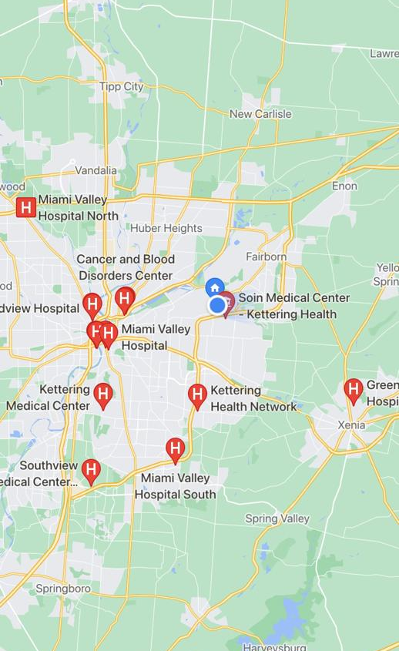
Problem
Lack of proper guidance for ambulance drivers. People are losing their lives in finding the nearest hospital with required resources.
Lack of knowledge about Beds and medical resources available for front-line workers and the government.

Slide 3

How to fix this?
A web application with features
Suggest and Guide the ambulance drivers to the nearest and appropriate hospital based on our requirement.
Helping the front-line workers during pandemic to look up available hospital with required medical resources.
Provide stats about hospitals to the government.

Slide 4
Key Features
En-route based on beds availability and specialists' availability
Notification to Hospital
Provide information to Government regarding the hospital resources

Slide 5
Capabilities
Manage
Manage the hospital’s data
Share
Share the data with 911 Team
Directions
Provide directions to the nearest best hospital
Notify
Notify the hospital
Tracking
Updating the Resources data of all the hospitals to the Government

Slide 6
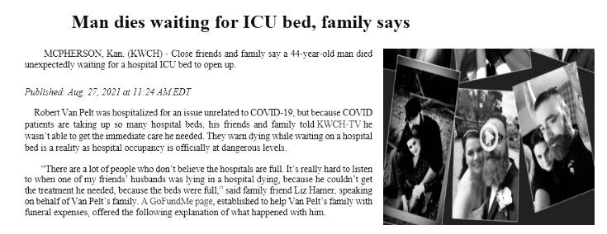
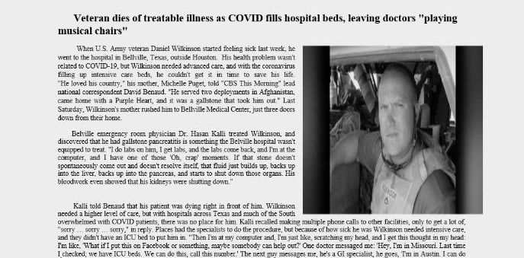
JUSTIFICATIONS
What is lacking in these scenarios?
With PH the gap can be bridged.
The application’s capabilities ensure no anomalies.
No life can be lost due to lack of correct information at prime time.

Slide 7
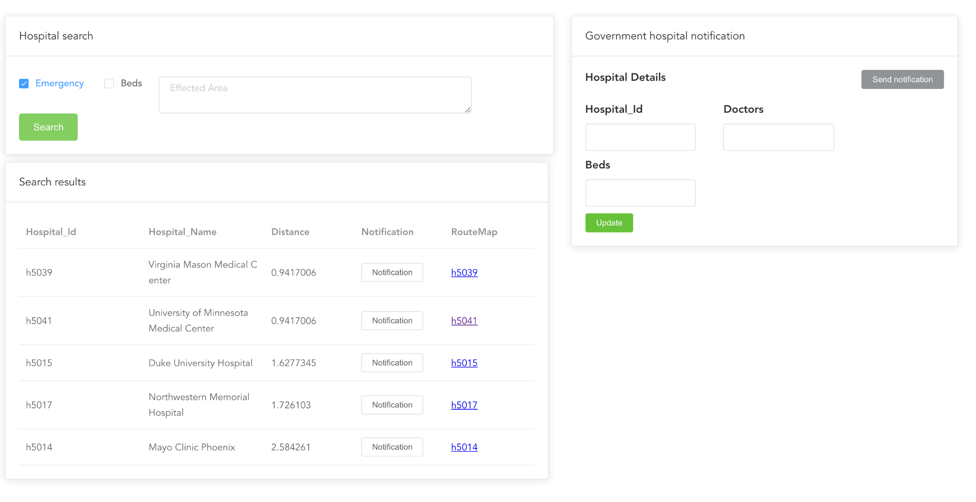
Prototype

Slide 8

How do we make money?
Yearly Subscription with low cost.
Support from Government.

Slide 9
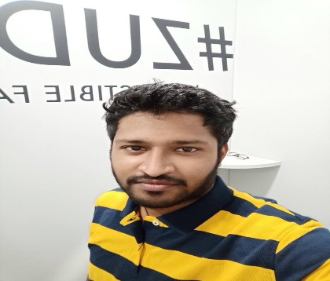
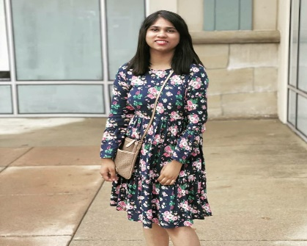
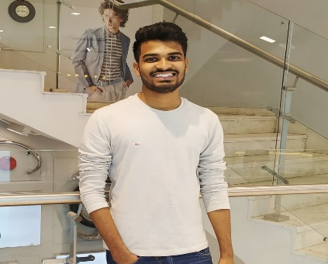
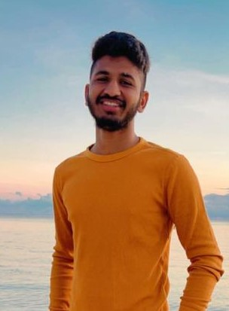

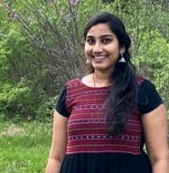
Team members
Srinivas Reddy Kothalachinta
Planning and Design, Cloud developer
Sainath Reddy Chennu
Backend Developer
Divya Gnana Preetham Yaddalapuri
Backend Developer and Testing
Sanjana Redddy Byreddy
Front-end Developer
Saveen Reddy Chapala
Database Programmer
Gayatri Kota
Integration and deployment

Slide 10
What do we need?
Support from any company to release the application.
All the hospitals must register to the application.
Cloud access to manage vast amounts of data.
Technical Validation.
How do we scale up ?
Promotions
Free subscription for 60 days.

Slide 11

Thank you
from Team PH.

